Slide 1
SIT216 User Centred Design
Topic 6
Interface Design & Emotional Design

Slide 2
Last topic...
Revision of interaction design paradigms and styles
Interaction design principles
Also:
Provide a good conceptual model
Make things visible so that intuitive understanding can occur with ease
Take advantage of natural mapping
Provide feedback

Slide 3
Last topic...
Learnability
Efficiency
Flexibility
Satisfaction
Robustness
Memorability
(Consistency)

Slide 4
This Topic
Fundamental graphical design principles
Harmony, Balance and Simplicity
Refinement, Unity, Restraint and Modularity

Slide 5
INTERACTION VS Interface design
1

Slide 6
Interaction Design vs Interface Design
Interaction Design is about how the user will complete the tasks needed to produce the required outcomes.
Interface Design is about how those tasks and outcomes are communicated to the user.

Slide 7
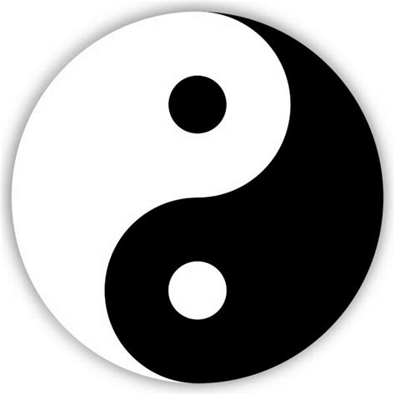
Fundamental Principles
Taste is “in the eye of the beholder”.
Aesthetic judgment is personal and emotional.
There are a few universal principles that have emerged over time and can be applied across all cultures.
harmony
balance
simplicity

Slide 8
Fundamental Principles
These three principles can best be achieved through a few simple methods.
refinement
restraint
unity
modularity

Slide 9
HARMONY
2

Slide 10
Harmony
The most important principle when applied to software interfaces.
Definition:
All elements of the interface fit together seamlessly.
The configuration of every perceived element blends to a pleasing, satisfying whole.

Slide 11
Harmony
When applied to interfaces, harmony is embodied in the visual relationship between elements. This includes:
the style and size of elements
the sequencing of information
the feedback given to the user

Slide 12
Activity - Which one “feels” right?
1.000
1.333
1.619
2.000

Slide 13
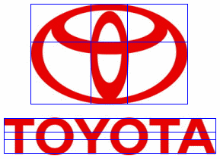
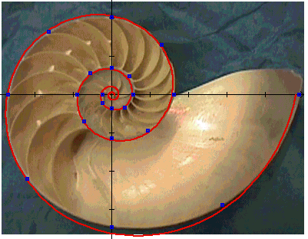
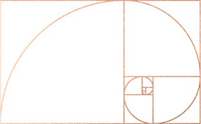
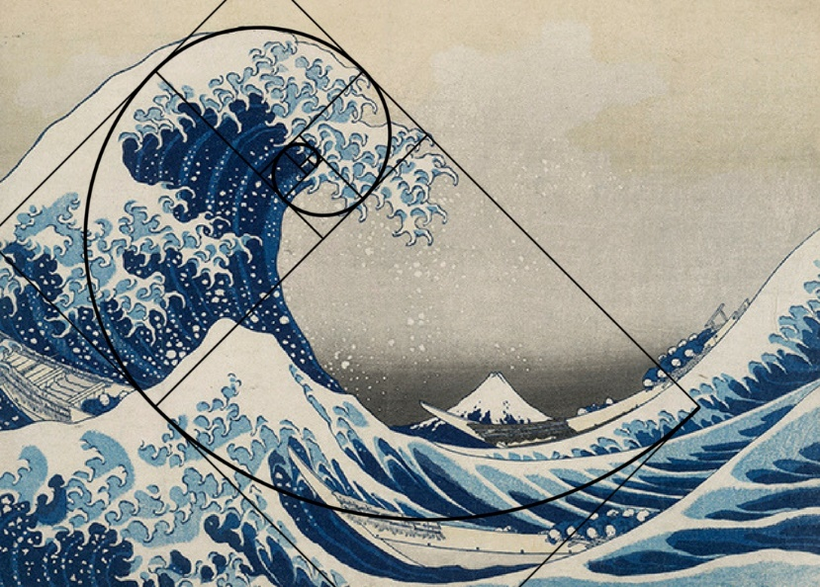
Activity - Which one “feels” right?
1.619
Notes:
Golden ratio 1.619
https://www.ucsart.com/fine-art-education/learn-the-golden-ratio
https://sites.google.com/a/maret.org/advanced-math-7-final-project-2014/math-in-everyday-life/the-golden-ratio-in-the-word-around-us

Slide 14
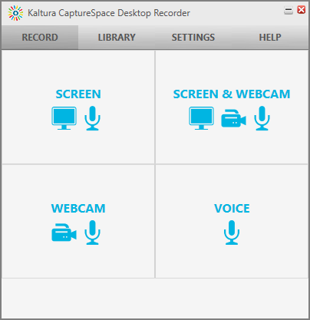
Harmony Examples

Slide 15
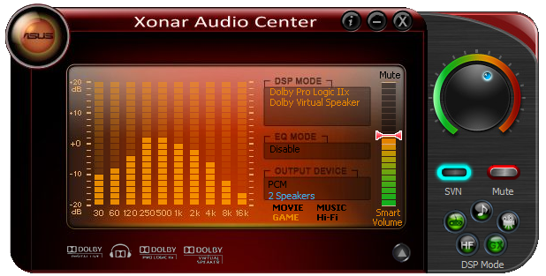
Harmony Examples

Slide 16
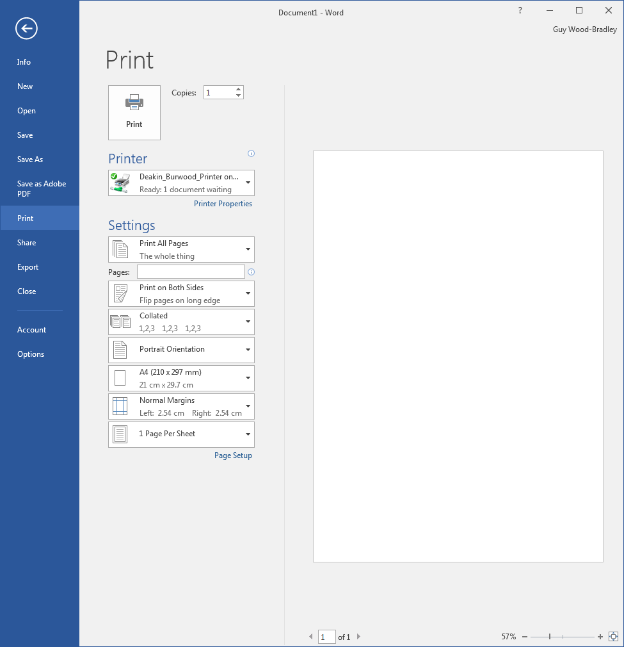
Harmony Examples

Slide 17
BALANCE
3

Slide 18
Balance
Balance refers to the arrangement of elements rather than the visual relationship between elements.
Symmetry is the simplest way of achieving balance.
Modern designers (artists, architects, etc.) like to achieve balance through asymmetry (a more difficult challenge).

Slide 19
Balance
Balance is frequently a layout problem.
Balancing size
Balancing orientation
Balancing “heaviness”

Slide 20
Activity - Balance
How would you move this shapes around to achieve ‘balance’?
Balancing size – ‘lightest’ to ‘heaviest’ or arranged another way to achieve ‘balance’?
Balancing orientation – should these rectangles be both horizontal or vertical (or something different)?
Balancing “heaviness” – re-order these from ‘lightest’ to ‘heaviest’

Slide 21
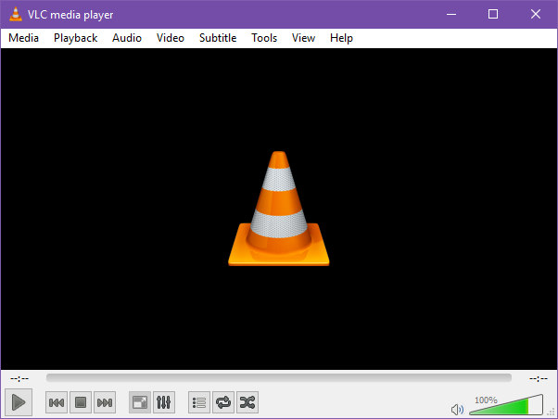
Balance Examples

Slide 22
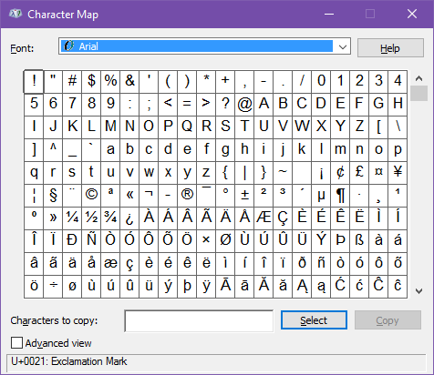
Balance Examples

Slide 23
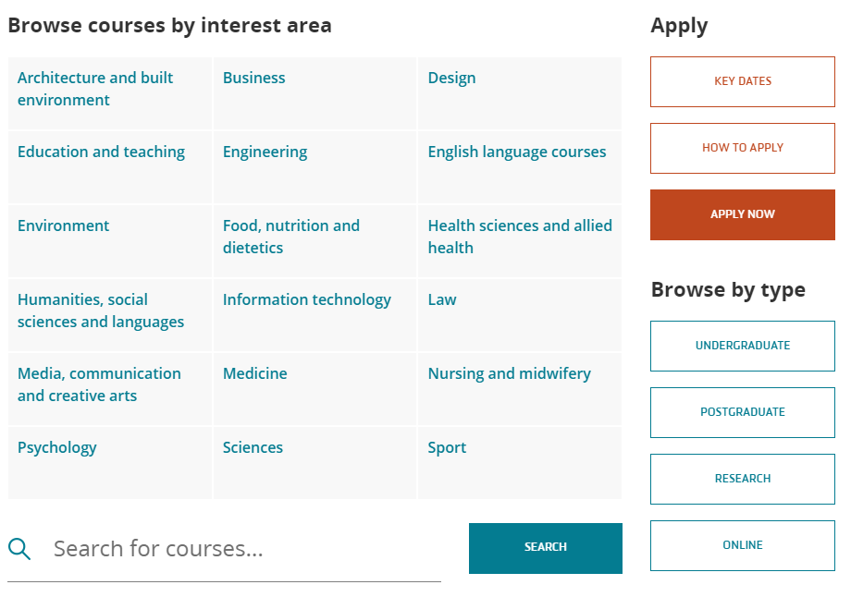
Balance Examples

Slide 24
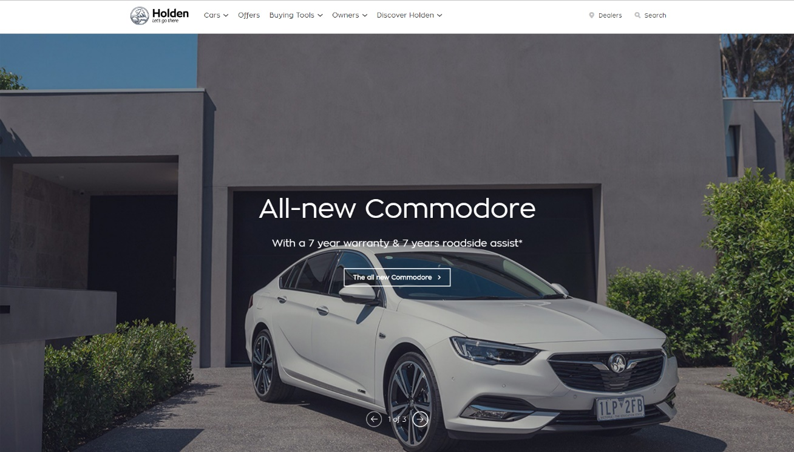
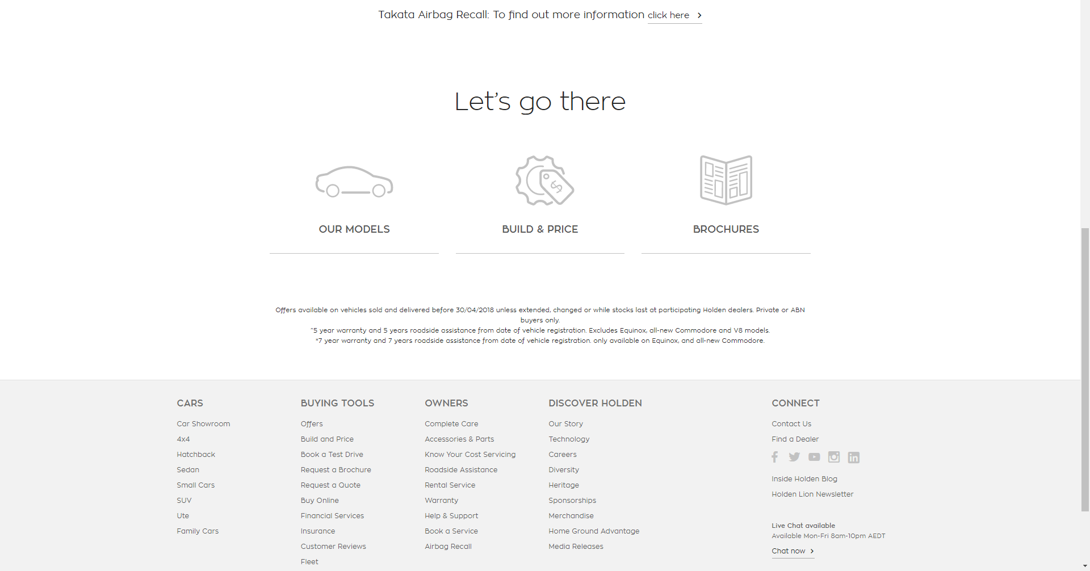
Balance Examples
Source: Holden

Slide 25
SIMPLICITY
4

Slide 26
Simplicity
Is not the reverse of complexity.
Simple does not mean plain.
Simplicity suggests sophistication, clarity, elegance, economy.
Is a synergism between balance and harmony.
Is achieved through iterative design.
For an interface, it also refers to the interaction model.

Slide 27
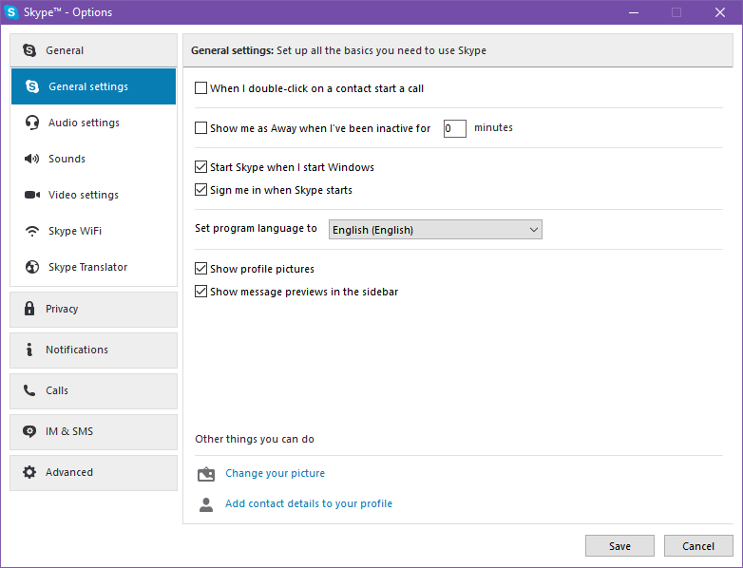
Simplicity Examples

Slide 28
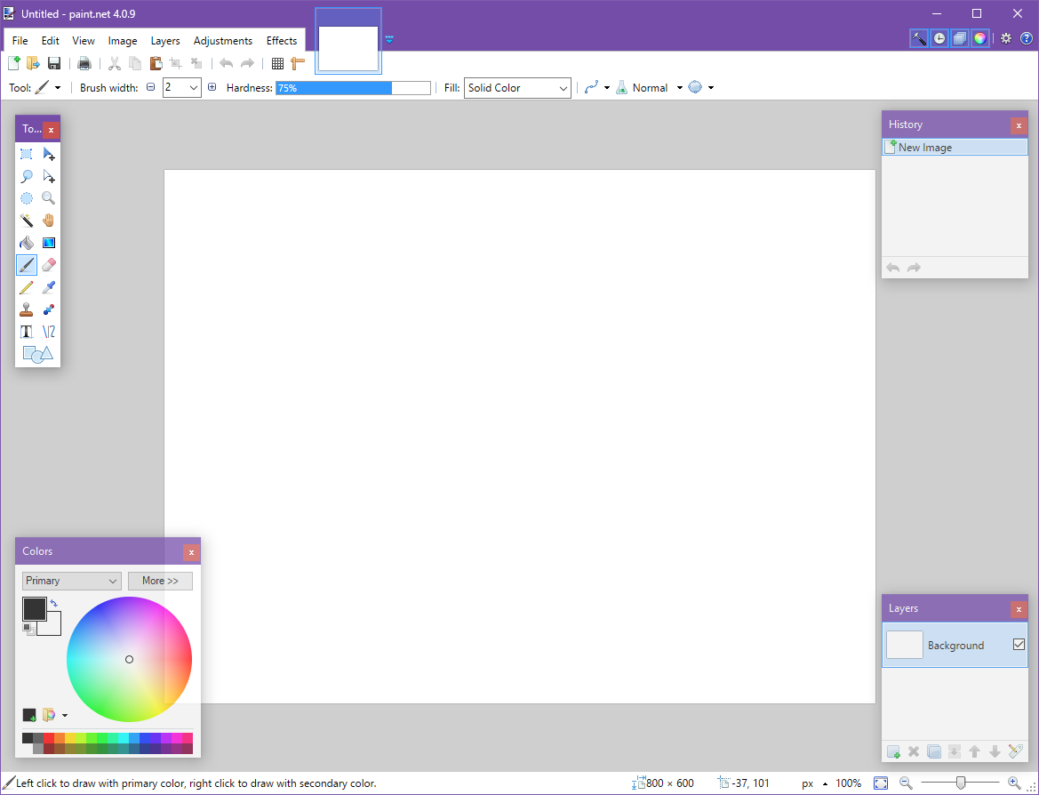
Simplicity Examples

Slide 29
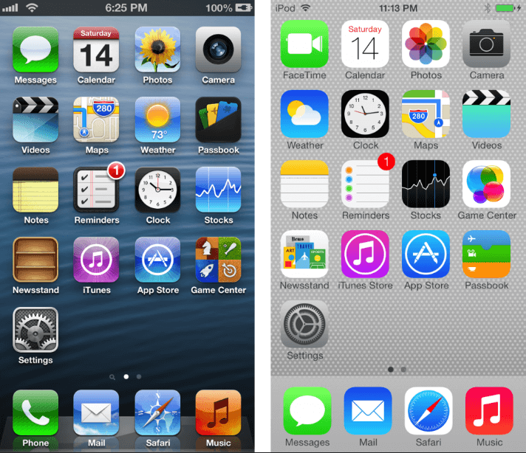
Simplicity Examples
Apple before iOS 7 (3D-like) – left
iOS after iOS 7 (flat) – right
Notes:
https://icons8.com/articles/why-are-so-many-companies-changing-to-flat-logo-design/

Slide 30
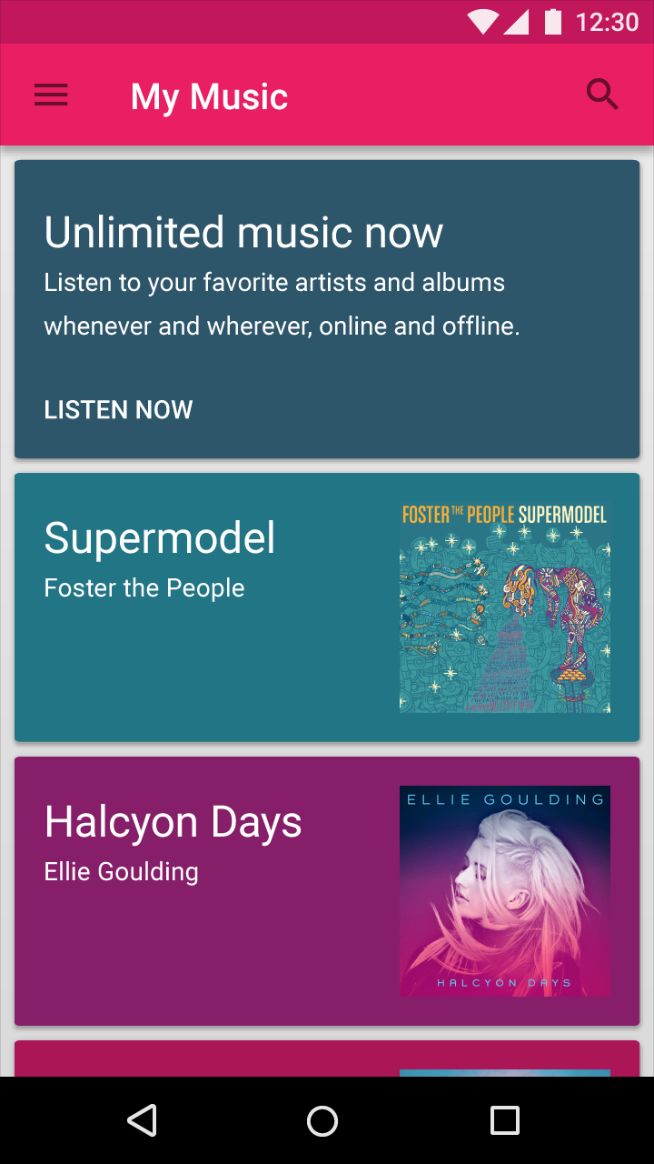
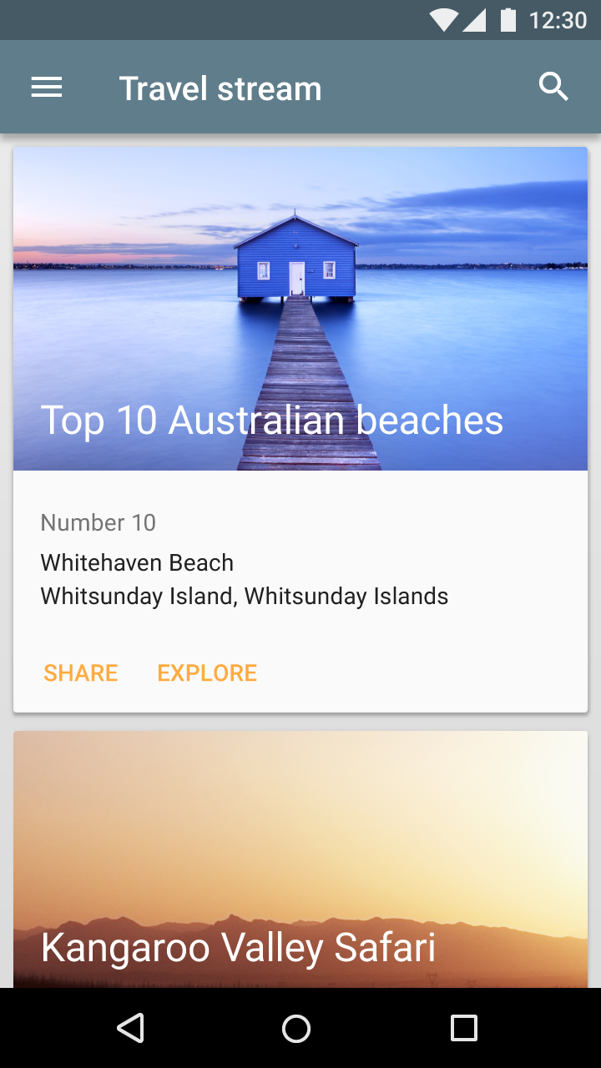
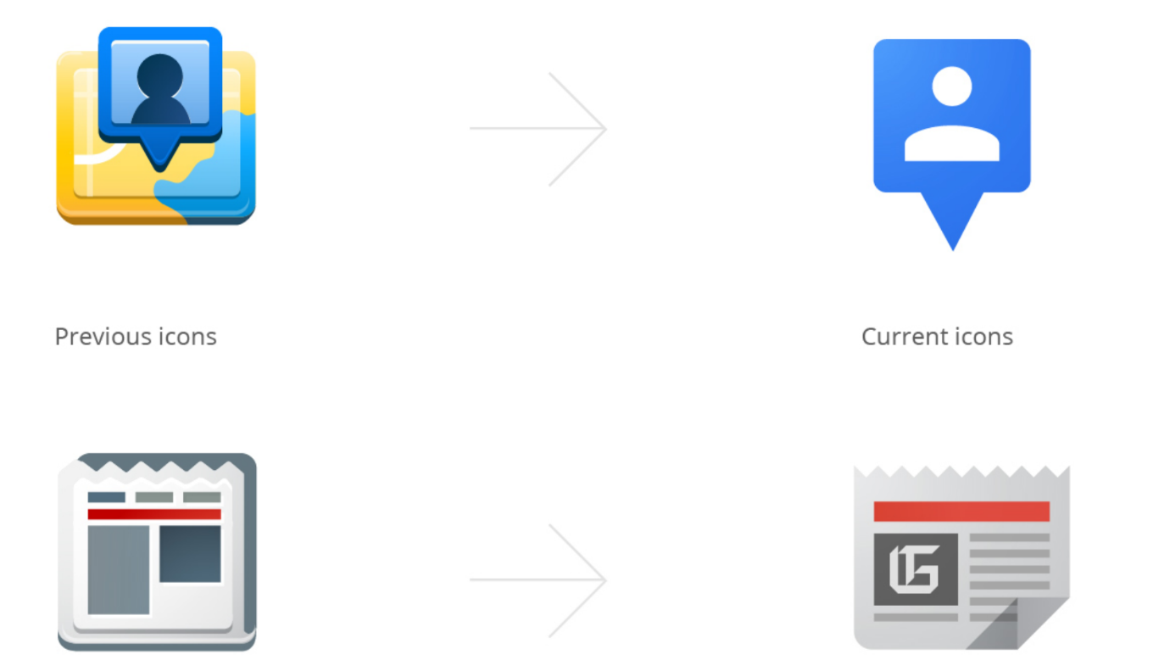
Simplicity Examples
Google Material Design: card based
Notes:
https://www.behance.net/gallery/9028077/Google-Visual-Assets-Guidelines-Part-1

Slide 31

Simplicity Examples
Microsoft – Fluent Design

Slide 32
Activity - Simplicity
Make some notes on how Apple, Google and Microsoft are currently focusing on simplicity.
Why do you think there is a focus on simplicity from these big players?
Are you aware of other companies following a similar pattern?
What other products/apps/systems have you seen (or used) that you would argue also demonstrate ‘simplicity’. How?

Slide 33
Design Methods
5

Slide 34
Design Methods
These three principles can best be achieved through a few simple methods.
refinement
restraint
unity
modularity
These methods are really guidelines for the designer.

Slide 35
Refinement
The process of design iteration.
You begin by trying alternate solutions.
Examine every element to identify problems in harmony, balance and simplicity.
Eliminate anything that does not contribute to the concept.

Slide 36
Restraint
An elegant solution is arrived at by using the absolute minimum of elements.
Features are not added to the product simply to “bulk it up”.
Interface properties are not adjusted to suit your own preferences.

Slide 37
Unity
Unity refers to the visual connections between interface elements.
A unified product is inherently balanced and harmonious.

Slide 38
Unity
There are a number of ways to create unity:
make elements the same size and shape
align elements vertically or horizontally
arrange elements so that one element merges into the next (closure)
make use of repetition
The arrangement of white space is just as important as the arrangement of elements.

Slide 39
Modularity
Design modules are elements that have the same size, shape and proportion.
The use of design grids is an attempt to achieve modularity.
By grouping interface elements with frames, boxes, etc. we can manipulate the boxes rather than the individual elements.

Slide 40
EXAmples
6

Slide 41
Activity – Interface Design
With the following examples, consider the principles and interface design factors presented in this topic
Provide a very short evaluation for each example (a checklist is acceptable).

Slide 42
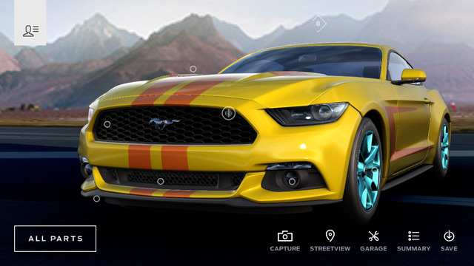
Example 1

Slide 43
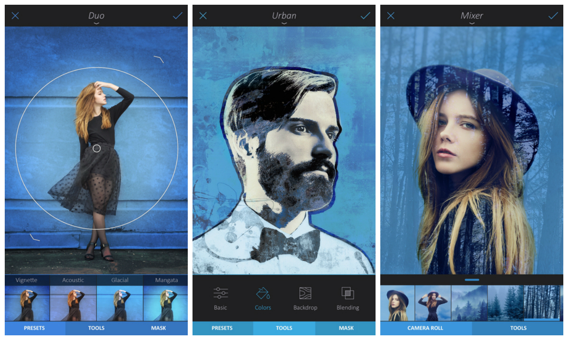
Example 2

Slide 44
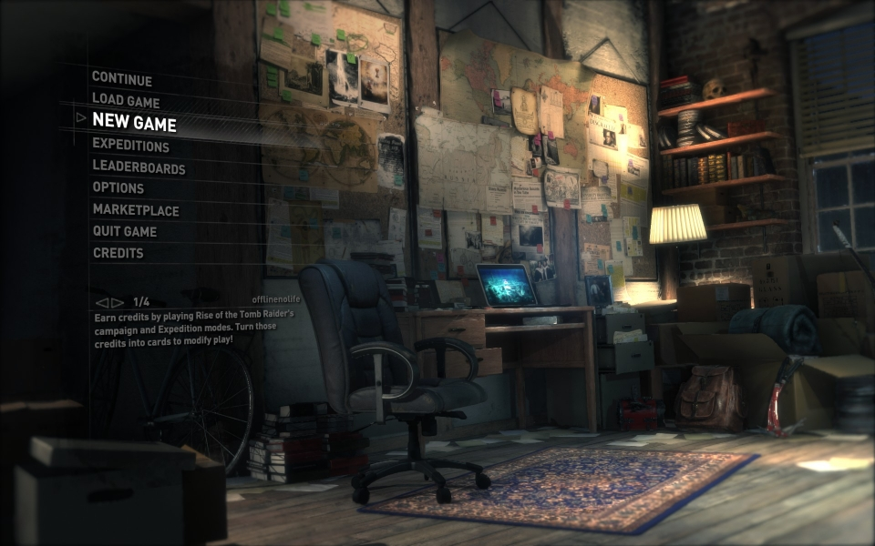
Example 3

Slide 45
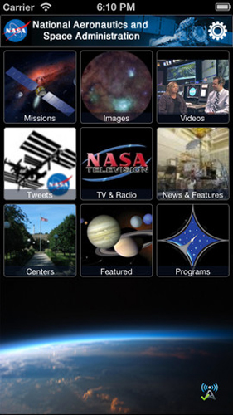
Example 4

Slide 46
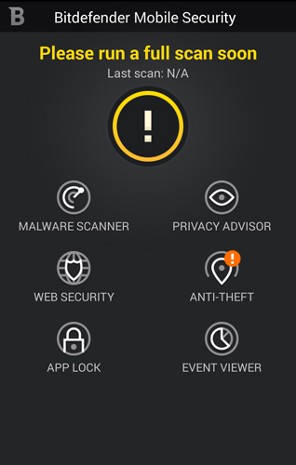
Example 5

Slide 47
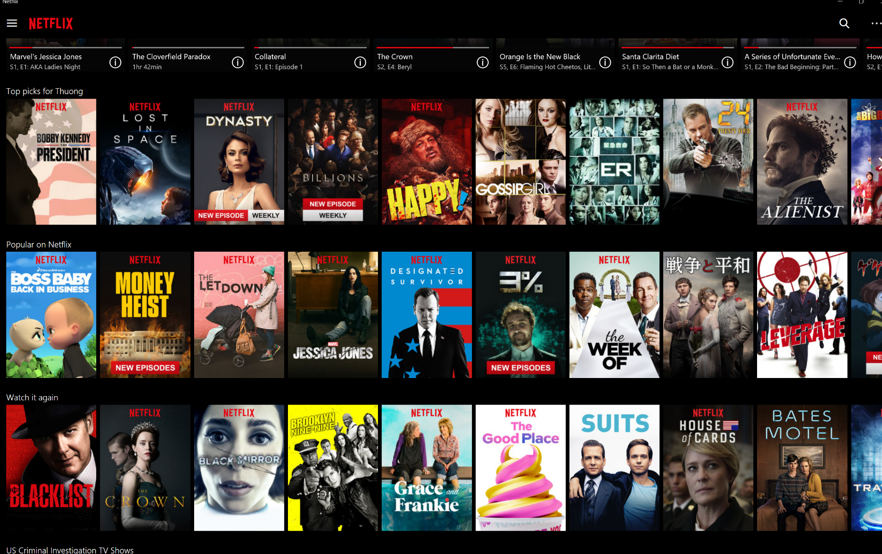
Example 6

Slide 48
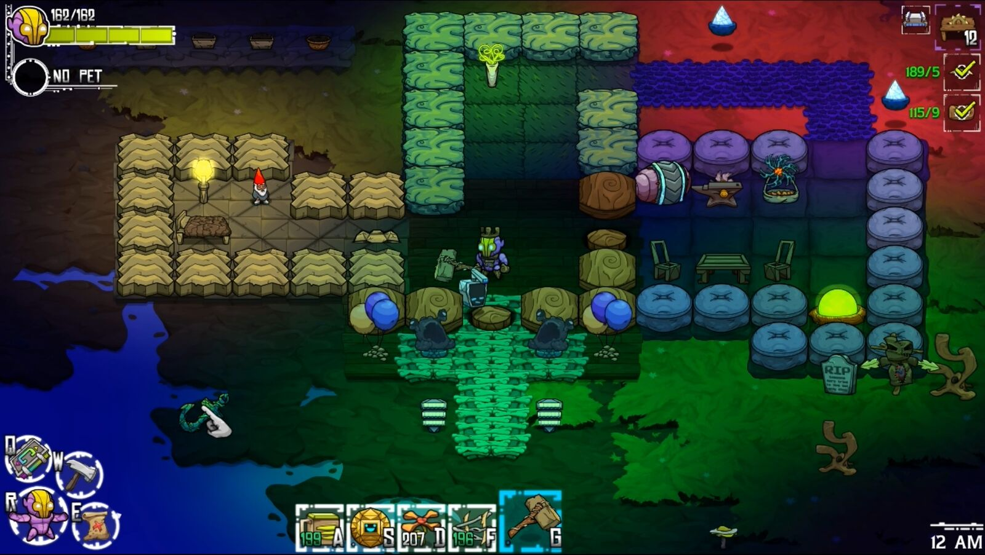
Example 7

Slide 49
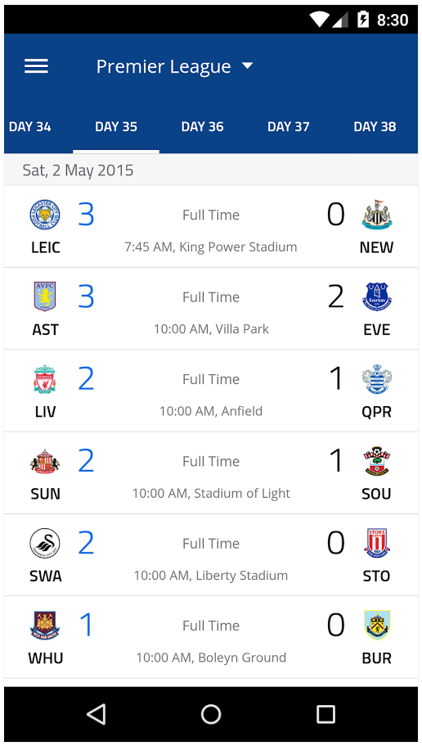
Example 8

Slide 50
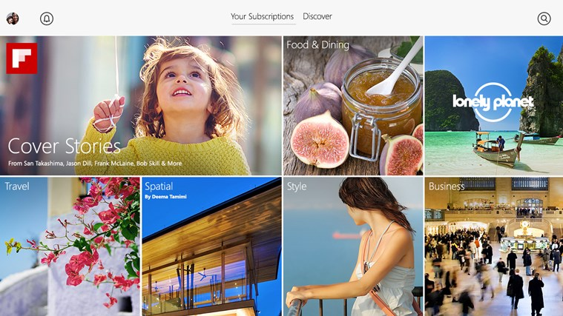
Example 9

Slide 51
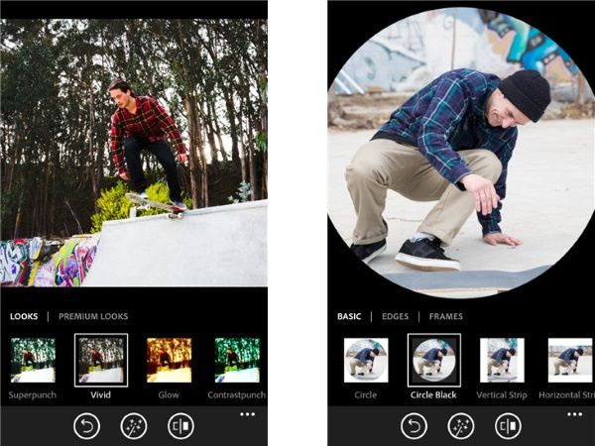
Example 10

Slide 52
EMOTIONAL DESIGN How do you feel?
7

Slide 53

http://www.eftspain.com/Owntechniques.html

Slide 54
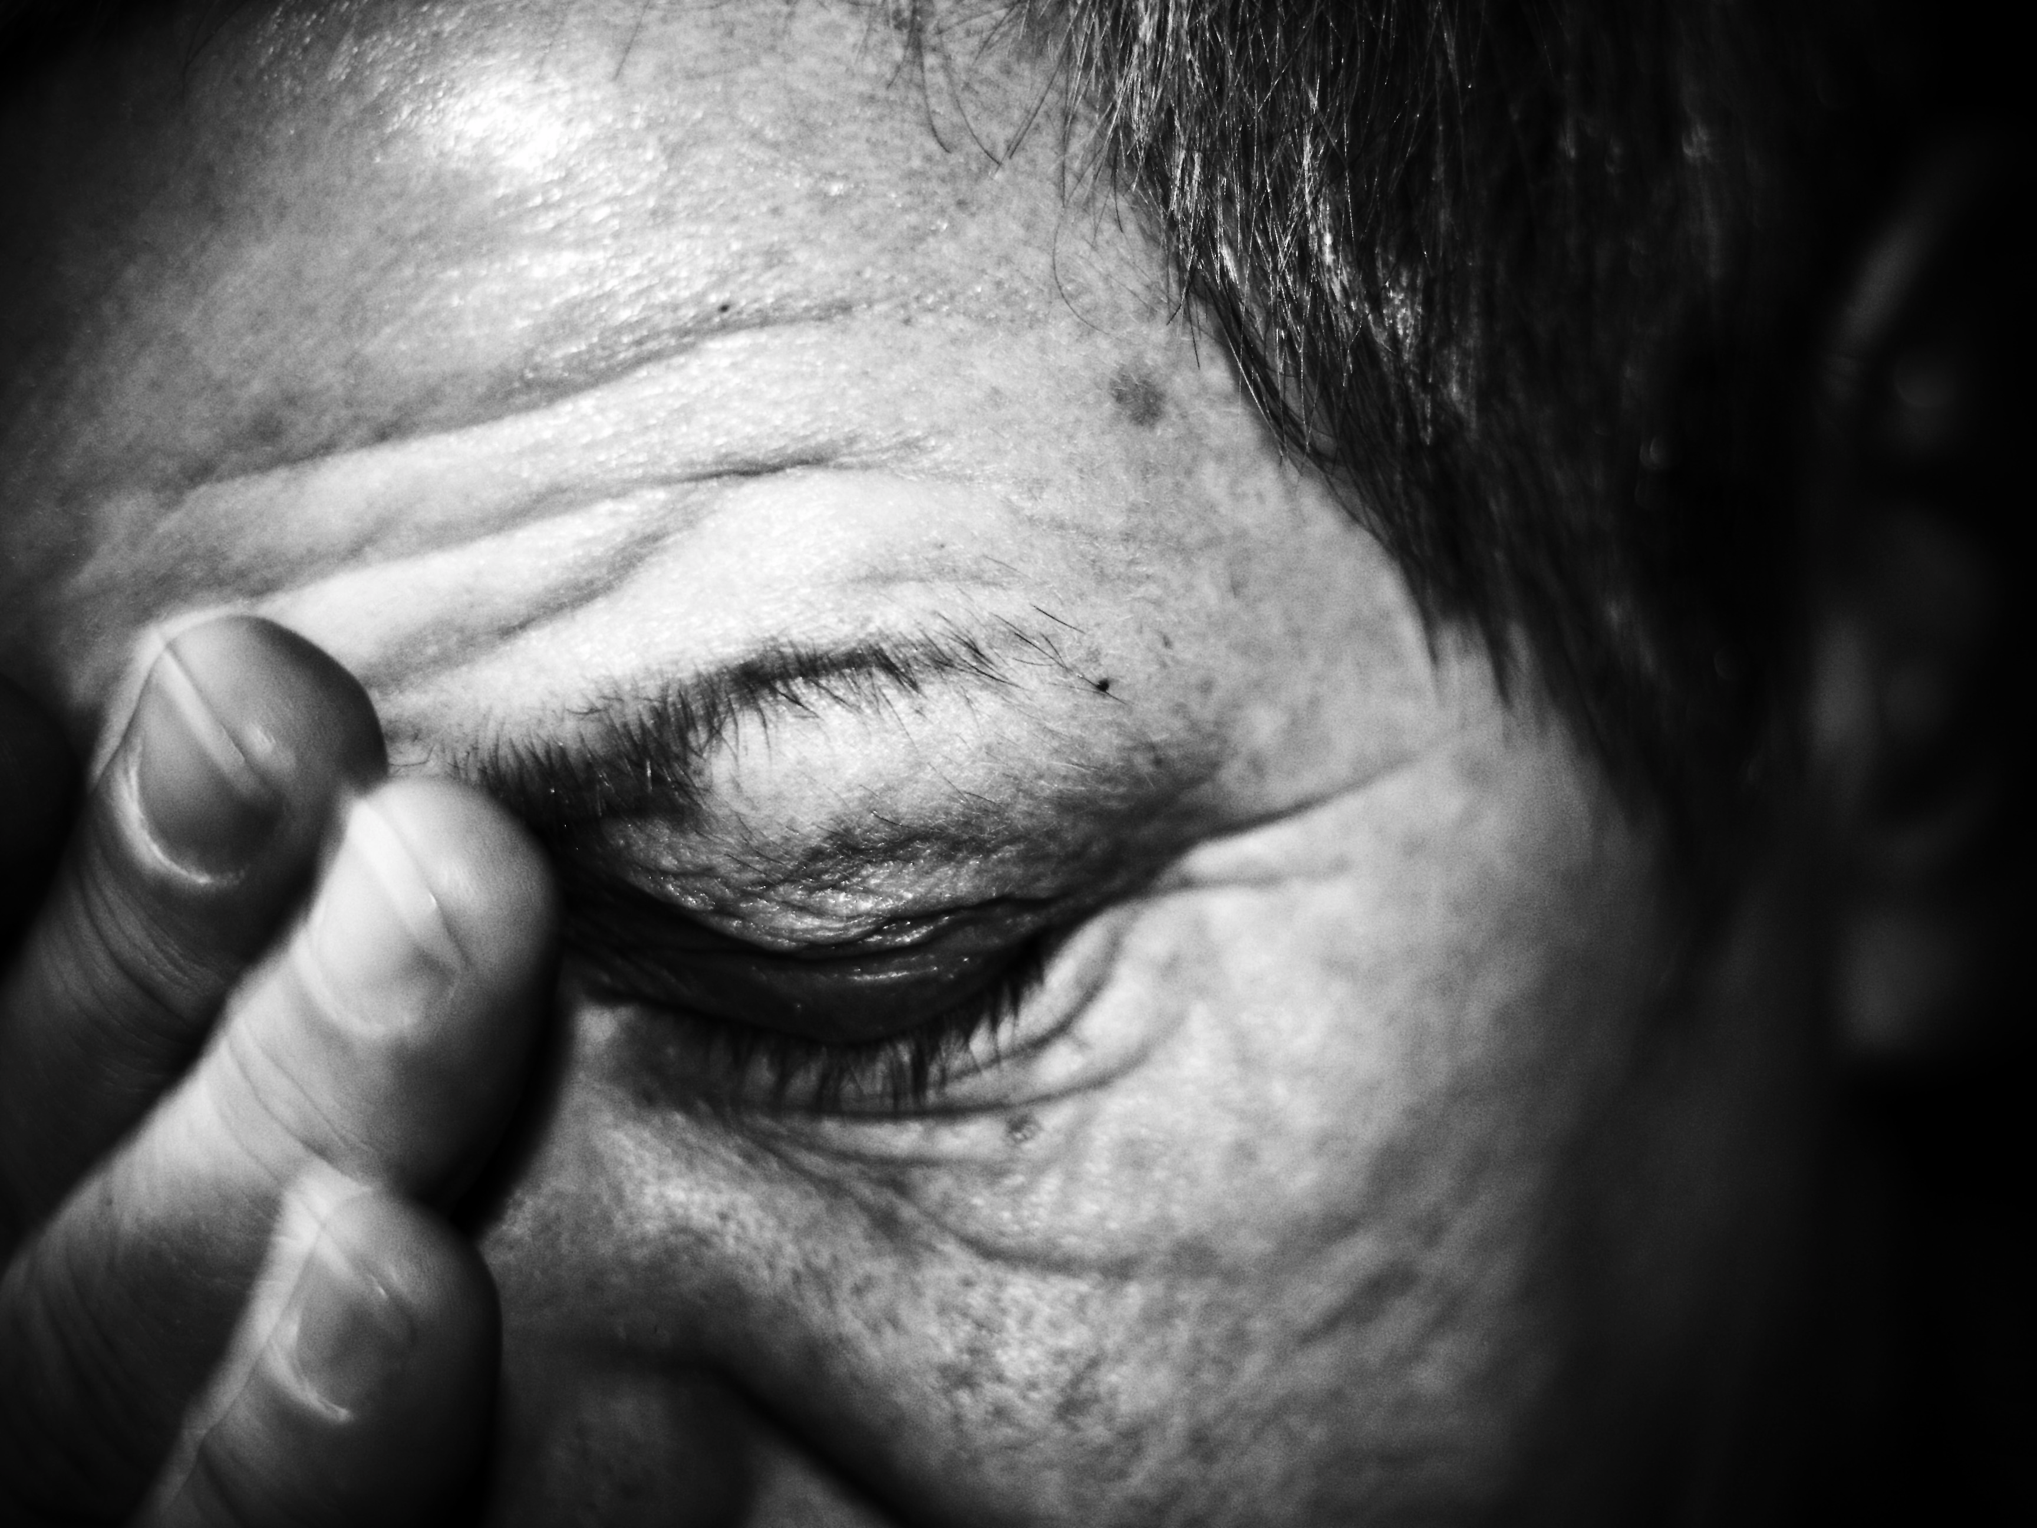
http://blackgirlsguidetoweightloss.com/its-all-mental/the-difference-between-enjoying-eating-and-emotional-eating/

Slide 55
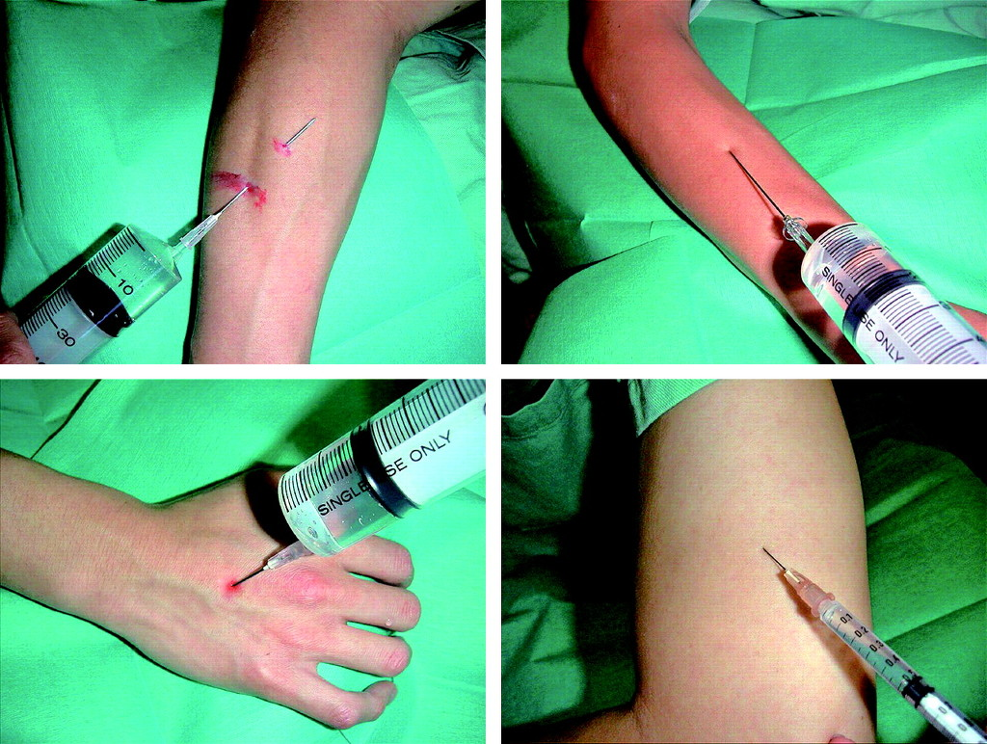
http://www.zooomr.com/z/photos/zoom/9804805/size-16/

Slide 56
Activity - How do you feel?
Describe how each of the following interfaces make you feel
http://www.youku.com/
https://world.taobao.com/
http://shanghaitang.com/
http://ffp.airchina.com.cn
http://www.huawei.com/cn/
https://www.lenovo.com.cn/

Slide 57
definitions
8

Slide 58
Definitions
Affect is a feeling or emotion as distinguished from cognition, thought, or action.
Effect is the state of being operable leading to accomplishment and fulfillment.
Or: emotions (affect) and actions (effect)

Slide 59
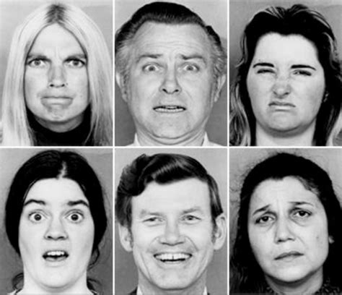
Definitions
Six basic emotions:
Anger – Happiness – Surprise – Disgust – Sad - Fear
Paul Ekman, 2013

Slide 60
Moods and Emotion
Moods are not directed at any object in particular and are experienced as more diffuse, global, and general state
a person can be sad about something – an emotion
or generally depressed - a mood

Slide 61
Emotions vs Feelings
Feelings are often pointed towards a class of objects, beings distinguishable through a certain property
I love Adobe CC applications!
I hate text-editing applications

Slide 62
Emotion and Memory
Negative events, which tend to be highly arousing, are typically remembered better than positive events.
What is your best happy memory at school?
What is your worst memory at school?
Which is easier to remember?

Slide 63
Emotional design vs effective usability
Emotional design
Emotional responses to interaction
Affect on the User Experience (UX)
Acknowledgment of “Human” in HCI
Effective usability
Operational characteristics
Can the user accomplish the tasks?
System focus

Slide 64
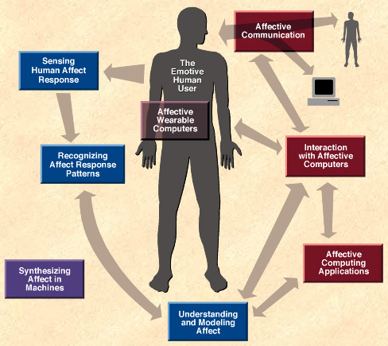
Affective Computing
Systems that intentionally focus emotional input/output and interpretation as a central principle.
Examples?
https://www.emotiv.com/
MIT Media Lab
Pepper (Nao robot)

Slide 65

Affective Computing
Notes:
https://vimeo.com/202980227

Slide 66
What is Emotional design?
…or “affective usability”
“Affective” = emotions
“Usability” = ease of use
Measuring the usability based on the way user feels
Does the interface make me angry, annoyed, happy, excited, interested, etc
Remember these emotions arise from the visual aspects AND the interactive aspects

Slide 67
What is Emotional design?
Usability paradigm shifts occur with the invention of new technology
Mobile phones colour screens cameras 3G and smartphones 4G and enhanced multimedia/internet capabilities 5G
As technology evolves, so does the way users interact with it.
Usability changes.
For example: GUI (non-gesture) to NUI (gestures/motion) cause changes in emotional responses they evoke.

Slide 68
What is Emotional design?
New style/design/products may appeal to users own likes, or with the aid of marketing:
Apple: “Pros love iMac. So we created one just for you. It’s packed with the most powerful graphics and processors ever in a Mac, along with the most advanced storage, memory and I/O — all behind a breathtaking Retina 5K display in a sleek, all-in-one design. For everyone from photographers to video editors to 3D animators to musicians to software developers to scientists, iMac Pro is ready to turn your biggest ideas into your greatest work.”
Causes emotional responses and reactions.

Slide 69
Activity - What is Emotional design?
Make a short list of items you have purchased or apps/systems you have (or still) use that were due to emotional reactions/responses to something (like an advertisement) you had seen or heard
Have your feelings/emotions changed over time?

Slide 70
Usability: NEW vs old
9

Slide 71
Usability: New vs Old
Emotions (Donald Norman)
From ‘traditional’ usability to ‘affective usability’ (emotional design)
Traditional: maximum efficiency
Affective: trade-off between efficiency and enjoyment
DVD/Blu-ray menus – exploration and engagement
How have streaming services designed their websites/apps?
Games – sometimes deliberate “poor” interface design to increase difficulty/make more challenging
Other products/systems examples?

Slide 72
Usability: New vs Old
New ways of thinking
Emotional responses that motivate users to learn/interact with an interface
Users perception on usability are impacted on the aesthetics of the interface
Establishment of trust through professional interface design; important in e-commerce and when making transactions on the WWW

Slide 73
EMOTIONAL DESIGN: what’s the big deal?
10

Slide 74

Emotional Design: What’s the big deal?
Often ignored in interaction design; how do we know the emotional state of systems?
Systems exist that try and help a user, but not if these elicit negative emotional responses, eg, irritation
Cannot have true and user-centred interactive systems that do not cater/consider the emotional state of the user
Should not design systems for some ‘generic’ user but use scenario-based design, user personas

Slide 75
Emotional Design: What’s the big deal?
Systems that are adaptable to different users must be able to receive emotional feedback so it can then learn how each group wishes to interact with it
Avatars/virtual assistants – can they be enabled/disabled? Are they targeted at a specific user group?
What other systems/interfaces or products?
(Reynolds & Picard, 2001)

Slide 76
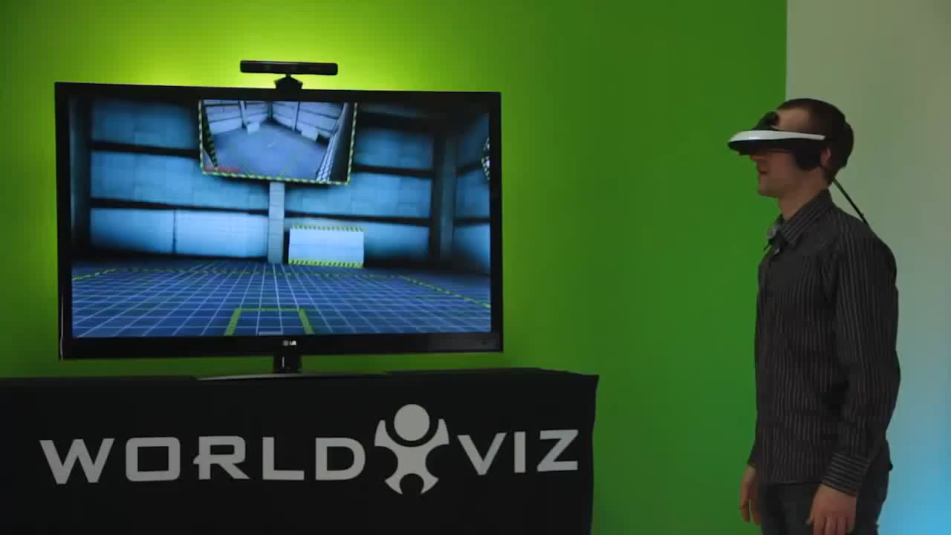
Emotional Design: What’s the big deal?
Notes:
https://www.youtube.com/watch?v=h8c6U7dpI7g

Slide 77
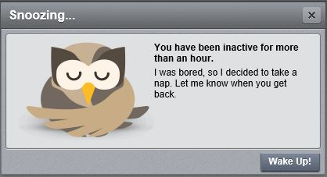
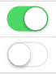
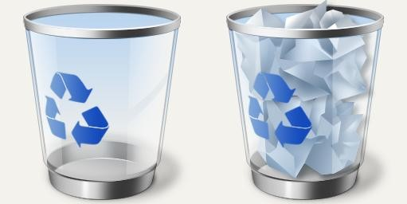
“Emotional” Interfaces?
Designers may create interfaces that evoke different emotions in the user
Alternatively, designers may use expressive icons/graphics to signal emotional states in an interface

Slide 78
“Emotional” Interfaces?
Designers can also consider using:
Recognition
Humour
Engagement
Dissonance
Tone of voice
Sabina Idler: http://www.smashingmagazine.com/2012/04/12/building-emotion-into-your-websites/

Slide 79
Activity - “Emotional” Interfaces?
Emotional review:
https://carbonmade.com/
http://mailchimp.com/
https://www.mint.com/
Positive? Negative? Indifferent?
Why?
Do we all agree on how these sites make us feel/our willingness to use/interact with them?

Slide 80
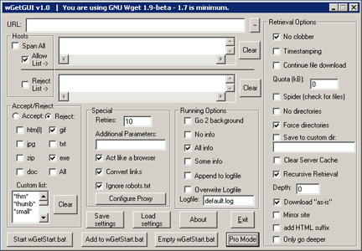
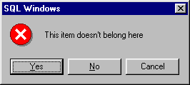
“Emotional” Interfaces?
A negative emotional response in poorly designed (the very opposite of ‘affective usability’ or ‘emotional design’)
Aim: positive emotions/reactions, not negative ones!

Slide 81
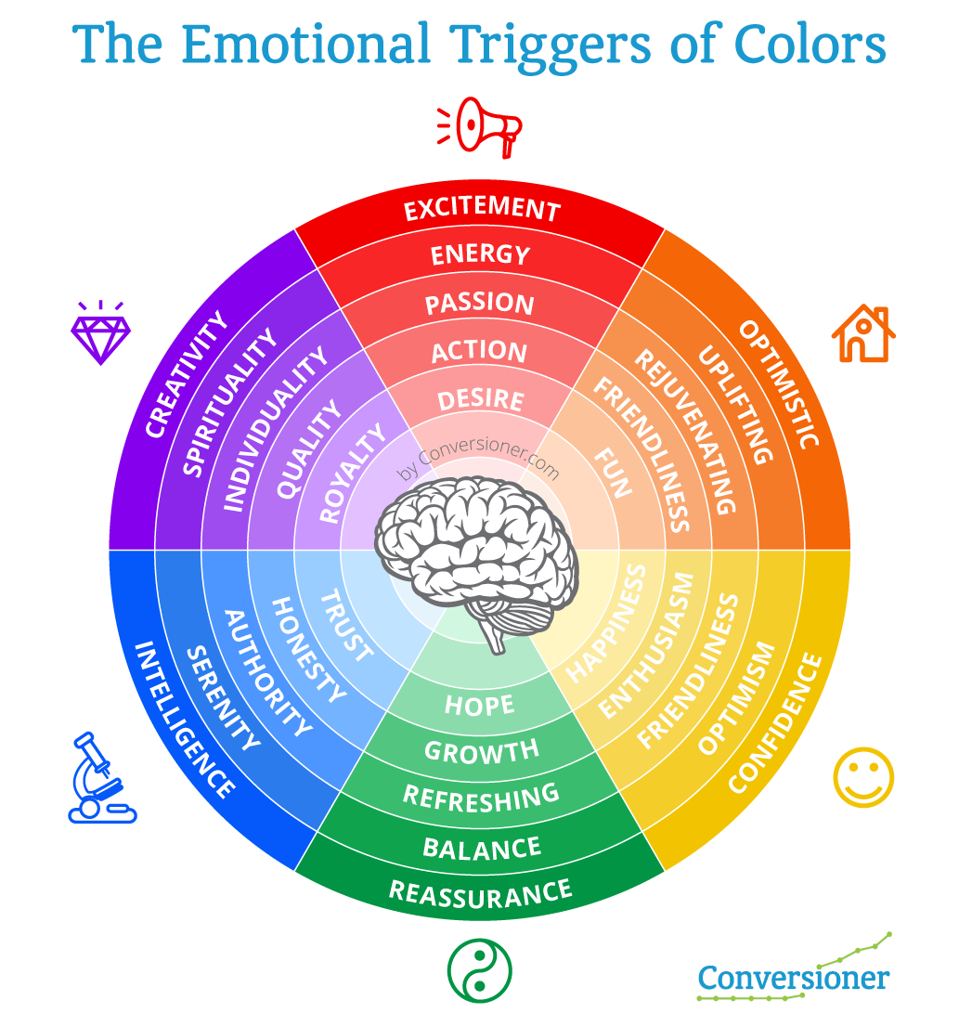
“Emotional” Interfaces?
Consider your colour options:
Source:
https://blog.hubspot.com/marketing/emotion-landing-pages

Slide 82
EMOTIONAL DESIGN IMPORTANCE
11

Slide 83
Emotional Design Importance
Boring interfaces – users loose interest – interface fails to be productive
Users in right frame of mind will complete tasks with ease (not frustrated)
User Centred Design (UCD) still important but also with attention to their emotional needs/requirements
User still remains the focus of the design process.
If usability issues are present, users are more likely to tolerate them if the interface is aesthetically pleasing/enjoyable to use.

Slide 84
Further Reading
Norman, D. A. 2004, Emotional Design: Why We Love (Or Hate) Everyday Things, Basic Books.
Picard, R. W. and Reynolds, C. 2001 ‘Designing for affective interactions’, Proceedings from the 9th International Conference on Human-Computer Interaction, New Orleans, August 2001

Slide 85
Summary
Harmony, balance and simplicity are the key drivers for graphical design.
Designers use the methods of refinement, restraint, unity and modularity to achieve good design.
Affective (emotional) usability/design is just as, or in some instances, more important than ‘traditional’ usability.
Consider what emotional responses/feelings you want your users to experience when using your interface.
Ideally systems will respond accordingly to different emotional input/reactions from the user.

Slide 86
Next Topic...
Formal evaluation techniques

